Slide 1



DSC++ MICRO PROJECT
By MATHAVAN A

Slide 2



Definition:
In C++, the term define is generally associated with the preprocessor directive #define. It is used to define macros or symbolic constants before the actual compilation of the program. This means the replacement happens before compilation, during the preprocessing stage.

Slide 3
Title: Student Management System using C++
.
“This project is a simple Student Management System developed in C++. It allows users to efficiently store, manage, and retrieve student details such as Roll Number, Name, and Marks. The system provides basic operations like adding new students, displaying all records, searching for a student by roll number, and deleting student information. The aim of this project is to demonstrate practical use of C++ concepts like structures, vectors, and basic input/output operations.”

Slide 4
Objectives:
Methodology (Expanded)
To create an easy-to-use system for managing student information.
To learn implementation of CRUD operations in C++.
To practice using data structures like struct and vector.
“The project uses a structured programming approach. Student information is stored in a structure that contains Roll Number, Name, and Marks. A vector is used to dynamically store multiple student records, which allows easy addition and deletion of data. The program provides a simple menu interface that guides users through available options. Each feature, such as adding, searching, displaying, and deleting records, is implemented using separate functions for clarity and maintainability. This methodology ensures that the program is organized, readable, and easy to modify or expand in the future.”

Slide 5
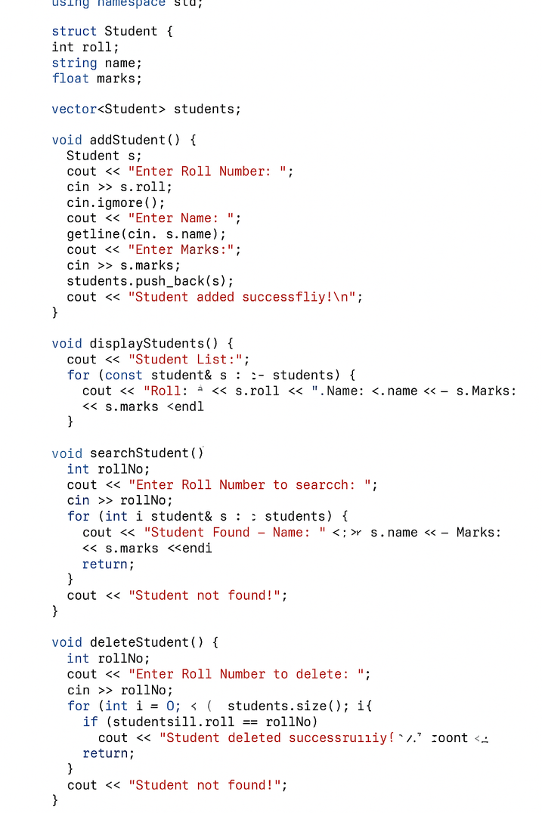
PROGRAM:
Features / Functionality (Expanded)
Add New Student: Allows the user to enter student details and store them in the system.
Display All Students: Shows all student records in a structured format.
Search Student by Roll Number: Finds and displays a specific student’s details.
Delete Student Records: Removes a student record from the system based on Roll Number.
Calculate Average Marks (Optional): Provides insight into overall academic performance.
User-Friendly Interface: Menu-driven system for ease of use and navigation.

Slide 6
PROGRAM LINK:
CLICK HERE
Benefits / Advantages:
Eliminates the need for manual record-keeping.
Reduces errors and ensures accurate data storage.
Helps students and institutions track performance efficiently.
Provides hands-on experience in C++ programming concepts.
Can be extended in the future to include additional features such as grade calculation, data sorting, or file storage.

Slide 7
Problem Statement / Motivation:
“In most educational environments, maintaining student records manually can be time-consuming, prone to errors, and difficult to organize. This project addresses that problem by creating an automated, structured, and reliable solution. By using this C++ program, users can easily handle student data without the need for paper-based records or complex software. The project also serves as a learning tool for understanding programming fundamentals and practical problem-solving techniques.”

Slide 8
EXAMPLE OUTPUT:
--- Student Management System ---
1. Add Student
2. Display Students
3. Search Student
4. Delete Student
5. Exit
Enter choice: 1
Enter Roll Number: 101
Enter Name: Mathavan
Enter Marks: 95
Student added successfully!

Slide 9
CONCLUSION
“The Student Management System developed in C++ is an effective, simple, and interactive application. It demonstrates the use of fundamental programming concepts in a real-world scenario. This project helps students understand how data can be organized, stored, and retrieved efficiently. Through this micro project, learners gain practical skills in programming logic, data management, and problem-solving. The system is easy to use, expandable, and can serve as a foundation for more advanced projects in the future.”

Slide 10
THANK YOU

